Slide 1



Slide 2

cloud wars
bulut savaslari

Slide 3





cloud wars
fthdgntr
fatihdgn
fatihdgn
fth.dgn@outlook.com
FATiH DoGAN
fatihdgn.com
Principal software developer
peakup.org/fatihdgn

Slide 4


cloud wars
vs

Slide 5
cloud wars
ortamlar
infrastructure as a service
Platform as a service
Container ve kubernates
entegrasyon
servisler
storage
database
big data
cognitive

Slide 6
cloud wars
ortamlar

Slide 7
cloud wars
ortamlar
infrastructure as a service

Slide 8


cloud wars
ortamlar
infrastructure as a service
vs
Amazon Elastic compute cloud (ec2)
Azure virtual machine

Slide 9
cloud wars
ortamlar
infrastructure as a service
vs
Azure virtual machine
Amazon Elastic compute cloud (ec2)
imajlar

Slide 10
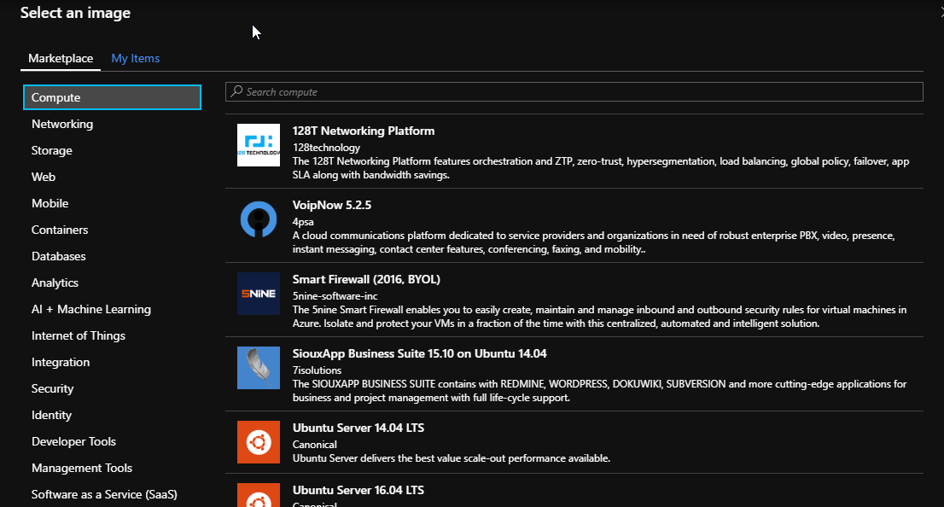
cloud wars
Azure vm
Amazon ec2

Slide 11
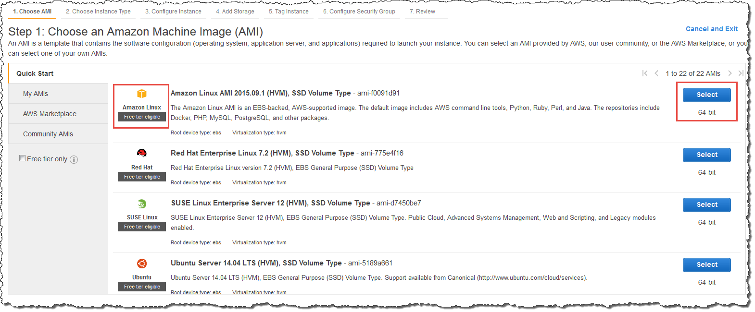
cloud wars
Azure vm
Amazon ec2

Slide 12
cloud wars
ortamlar
infrastructure as a service
vs
Azure virtual machine
Amazon Elastic compute cloud (ec2)
Gpu

Slide 13
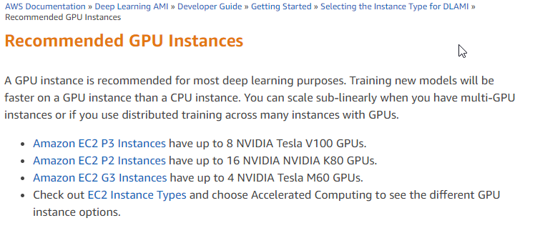
cloud wars
Azure vm
Amazon ec2
https://docs.aws.amazon.com/en_us/dlami/latest/devguide/gpu.html

Slide 14
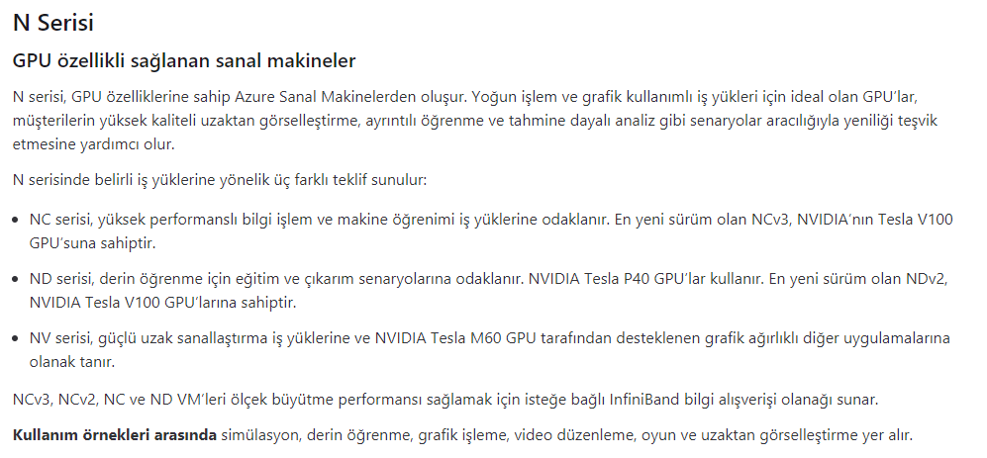
cloud wars
Azure vm
Amazon ec2
https://azure.microsoft.com/tr-tr/pricing/details/virtual-machines/series/

Slide 15
cloud wars
ortamlar
infrastructure as a service
vs
Azure virtual machine
Amazon Elastic compute cloud (ec2)
Auto-scale

Slide 16
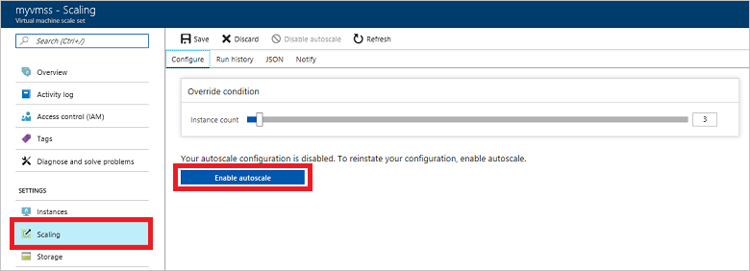
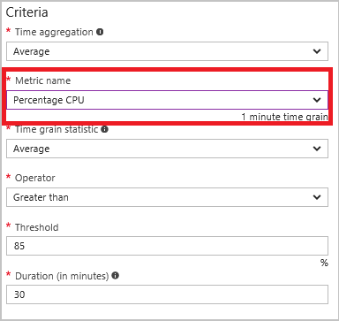
cloud wars
Azure vm
Amazon ec2
https://docs.microsoft.com/tr-tr/azure/virtual-machines/windows/autoscale

Slide 17
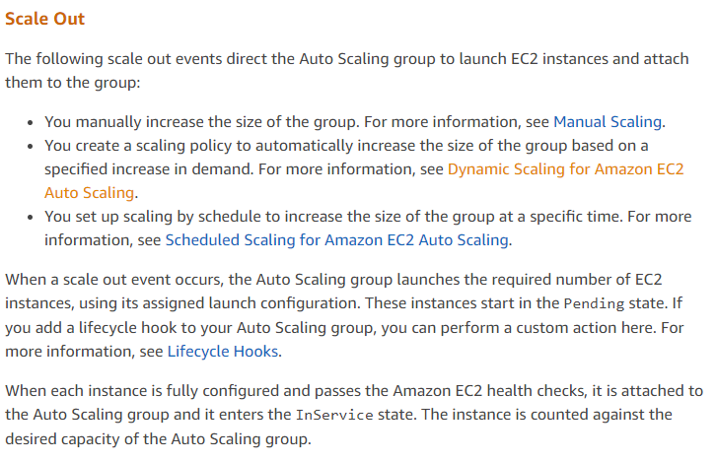
cloud wars
Azure vm
Amazon ec2
https://docs.aws.amazon.com/en_us/autoscaling/ec2/userguide/AutoScalingGroupLifecycle.html

Slide 18
cloud wars
ortamlar
infrastructure as a service
vs
Azure virtual machine
Amazon Elastic compute cloud (ec2)
fiyatlandirma

Slide 19
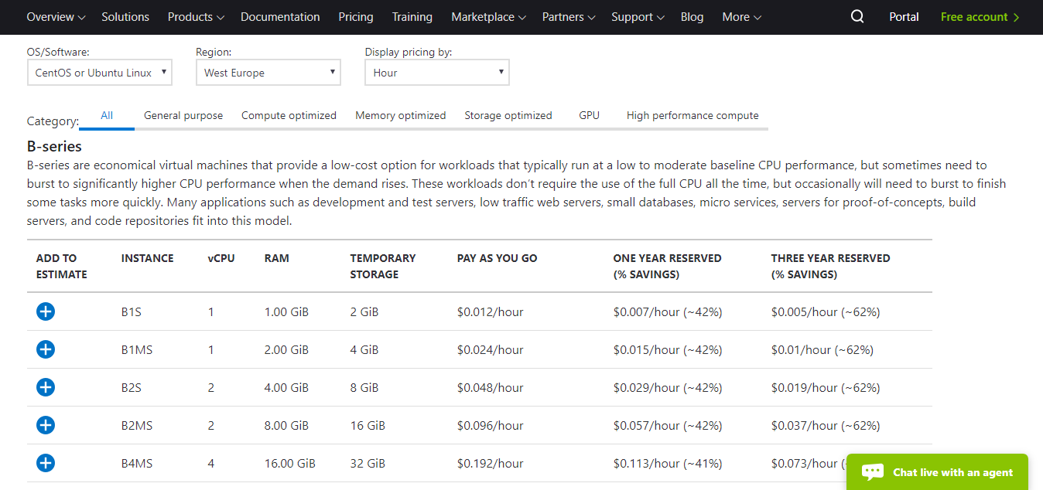
cloud wars
Azure vm
Amazon ec2
https://azure.microsoft.com/en-us/pricing/details/virtual-machines/linux/

Slide 20
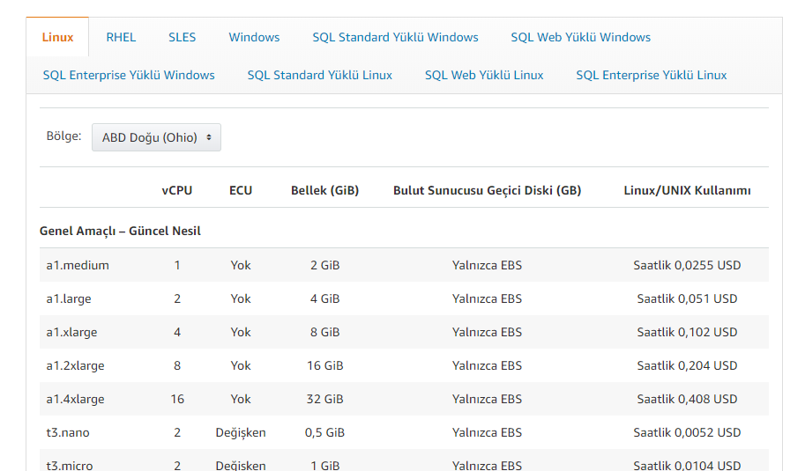
cloud wars
Azure vm
Amazon ec2
https://aws.amazon.com/tr/ec2/pricing/on-demand/

Slide 21
cloud wars
ortamlar
infrastructure as a service
vs
Azure virtual machine
Amazon Elastic compute cloud (ec2)
fiyatlandirma
B1S
1 vCPU
1 GB RAM
$0.012 / Hour
a1.medium
1 vCPU
1 GB RAM
$0.0255 / Hour

Slide 22
cloud wars
ortamlar
Platform as a service

Slide 23


cloud wars
ortamlar
Platform as a service
vs
Azure web app
Amazon Elastic Beanstalk

Slide 24
cloud wars
ortamlar
Platform as a service
vs
Azure Web app
Amazon Elastic Beanstalk
publish

Slide 25
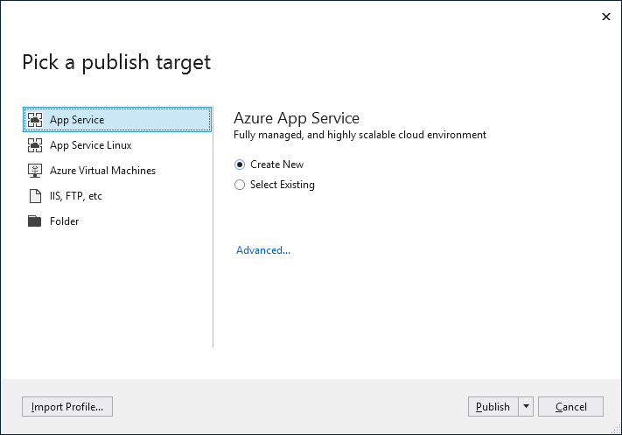
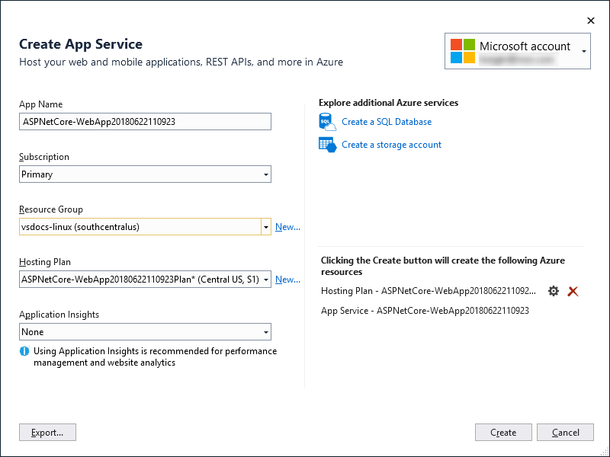
cloud wars
Azure web app
Amazon beanstalk
https://docs.microsoft.com/en-us/visualstudio/deployment/quickstart-deploy-to-azure?view=vs-2017

Slide 26
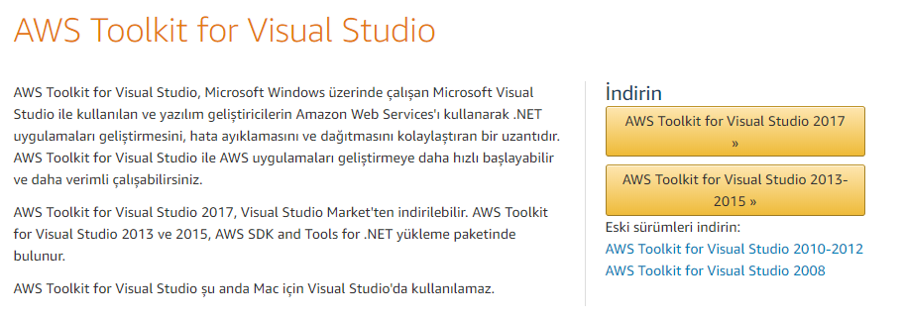
cloud wars
Azure web app
Amazon beanstalk
https://aws.amazon.com/tr/visualstudio/

Slide 27
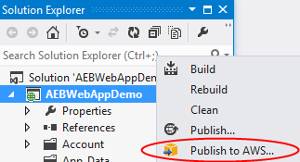
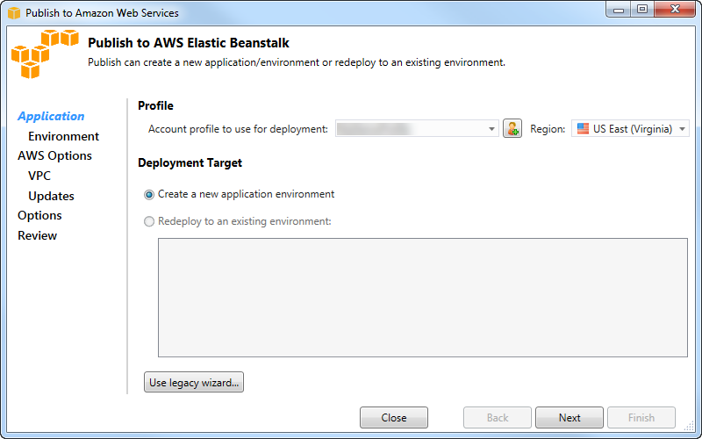
cloud wars
Azure web app
Amazon beanstalk
https://docs.aws.amazon.com/en_us/toolkit-for-visual-studio/latest/user-guide/deployment-beanstalk-traditional.html

Slide 28

cloud wars
ortamlar
Platform as a service
vs
Azure Web app
Amazon Elastic Beanstalk

Slide 29
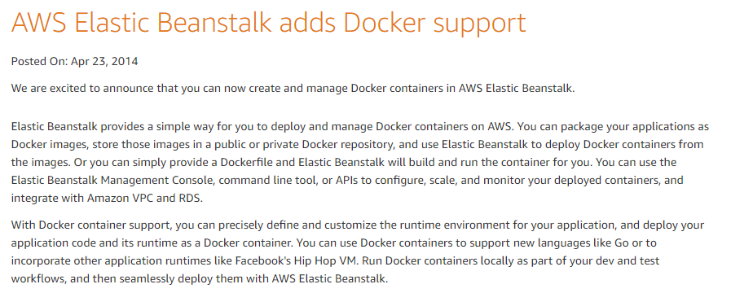
cloud wars
Azure web app
Amazon beanstalk
https://aws.amazon.com/tr/about-aws/whats-new/2014/04/23/aws-elastic-beanstalk-adds-docker-support/

Slide 30
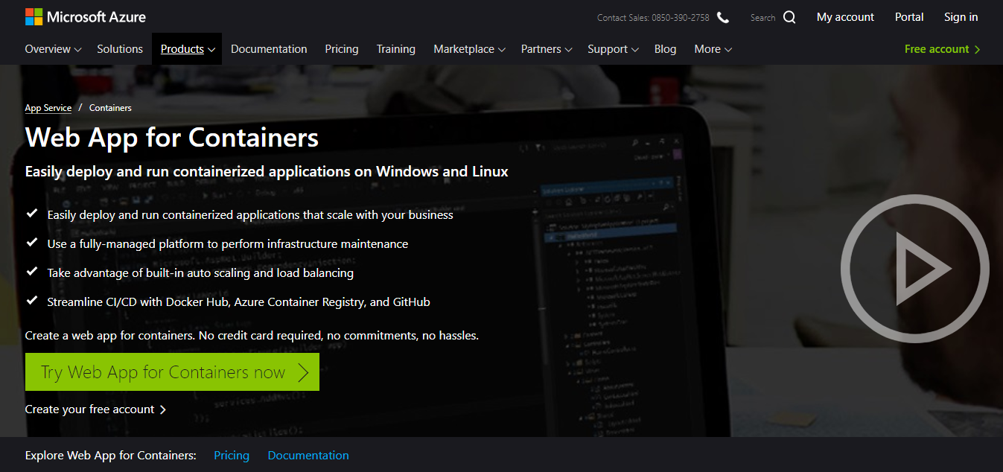
cloud wars
Azure web app
Amazon beanstalk
https://azure.microsoft.com/en-us/services/app-service/containers/

Slide 31
cloud wars
ortamlar
Platform as a service
Azure Web app
Site extensions

Slide 32
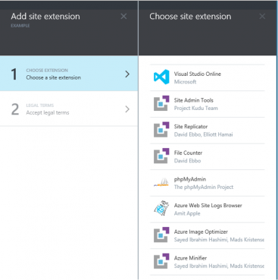
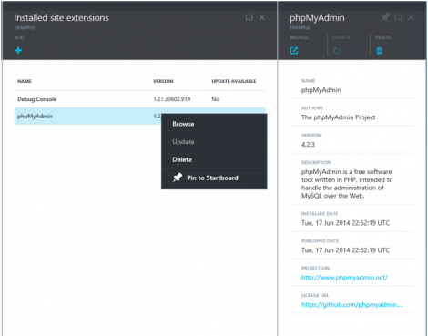
cloud wars
Azure web app
https://azure.microsoft.com/tr-tr/blog/azure-web-sites-extensions/

Slide 33
cloud wars
ortamlar
Platform as a service
Azure Web app
webjobs

Slide 34
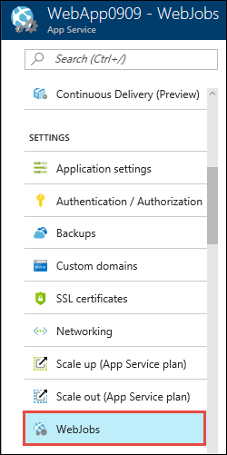
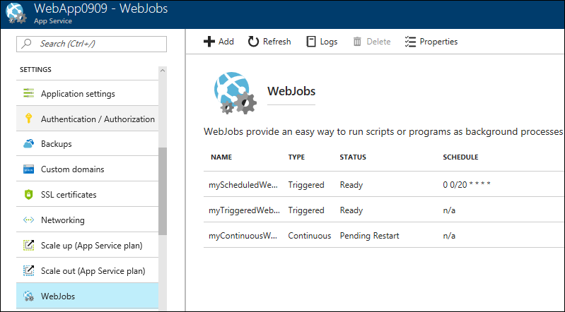
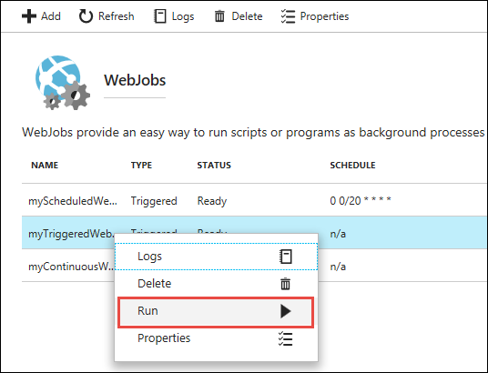
cloud wars
Azure web app
https://docs.microsoft.com/en-us/azure/app-service/webjobs-create

Slide 35
cloud wars
ortamlar
Platform as a service
Azure Web app
Authentication / authorization

Slide 36
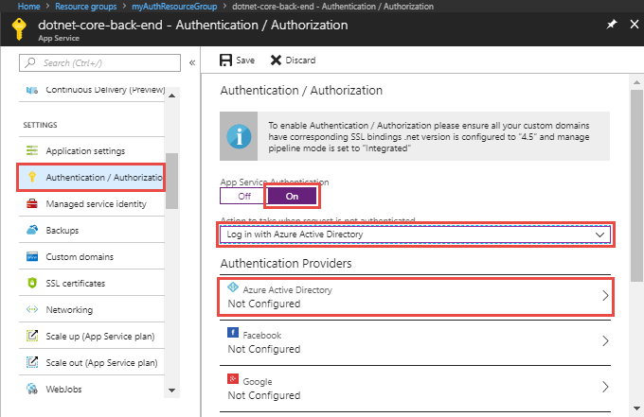
cloud wars
Azure web app
https://docs.microsoft.com/en-us/azure/app-service/app-service-web-tutorial-auth-aad

Slide 37
cloud wars
ortamlar
Platform as a service
vs
Azure Web app
Amazon Elastic Beanstalk
remote debugging

Slide 38
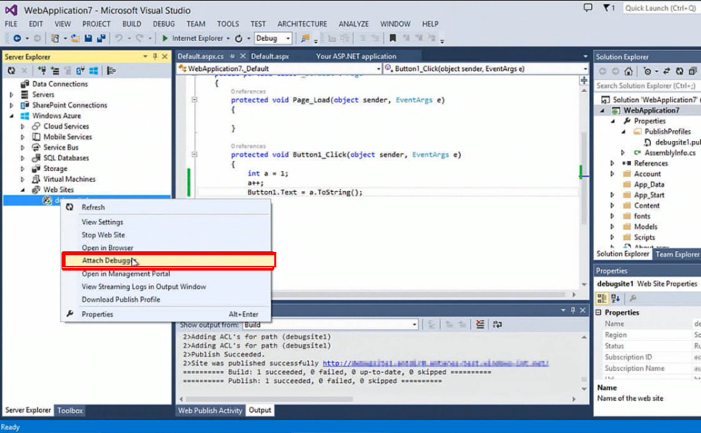
cloud wars
Azure web app
Amazon beanstalk
https://azure.microsoft.com/pt-br/blog/introduction-to-remote-debugging-on-azure-web-sites/

Slide 39
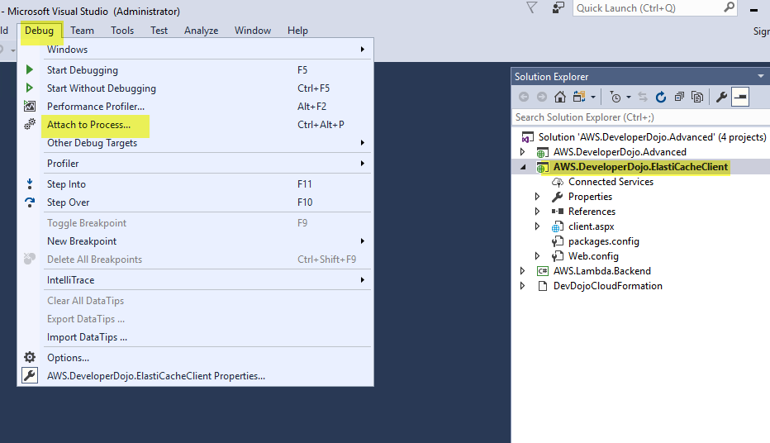
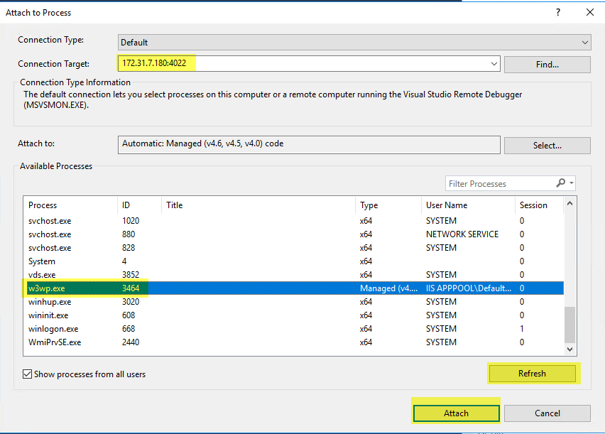
cloud wars
Azure web app
Amazon beanstalk
https://aws.amazon.com/tr/blogs/developer/remote-debug-an-iis-net-application-running-in-aws-elastic-beanstalk/

Slide 40
cloud wars
ortamlar
Container ve kubernates

Slide 41


cloud wars
ortamlar
Container ve kubernates
vs
Aws Elastic container service for kubernates
Azure kubernates service

Slide 42
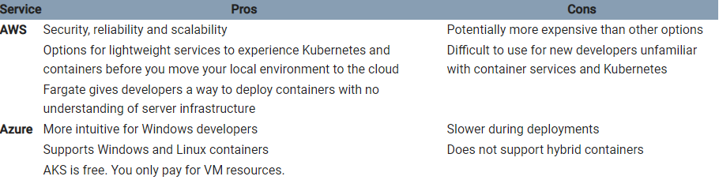
cloud wars
azure kubernates service
aws ecs for kubernates
https://www.sumologic.com/blog/cloud/kubernetes-aws-azure-gcp/

Slide 43
cloud wars
ortamlar
entegrasyon

Slide 44


cloud wars
ortamlar
entegrasyon
vs
Azure Functions
Aws lambda

Slide 45
cloud wars
ortamlar
entegrasyon
Azure functions
vs
Aws lambda
kod editoru
code editor

Slide 46

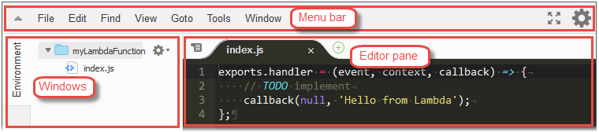
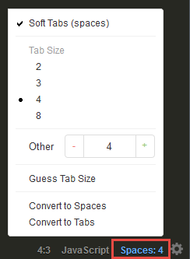
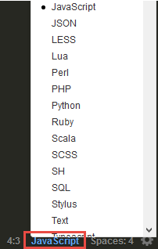
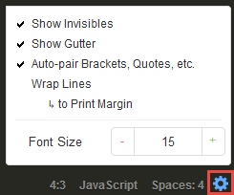
cloud wars
Azure functions
Aws lambda
https://docs.aws.amazon.com/en_us/lambda/latest/dg/code-editor.html

Slide 47
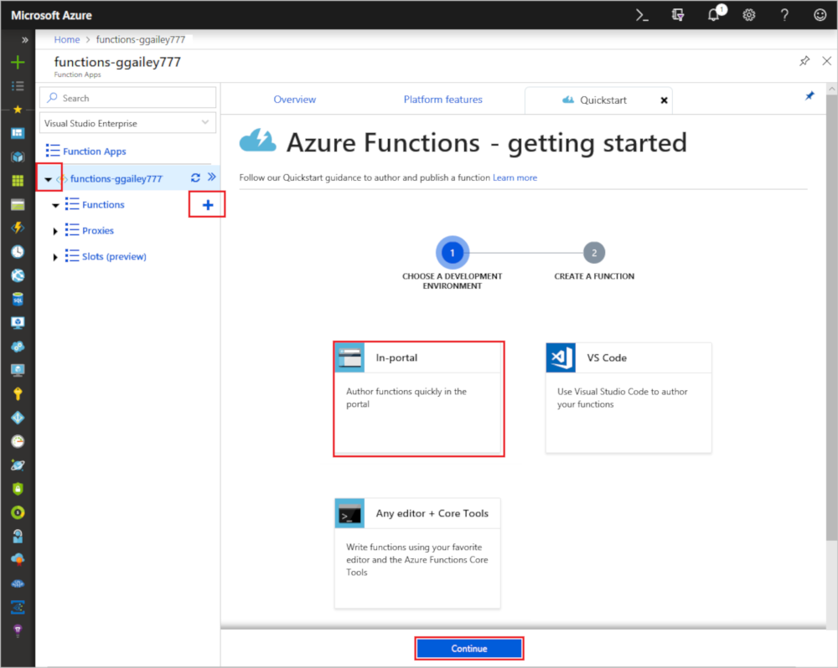
cloud wars
Azure functions
Aws lambda
https://docs.microsoft.com/en-us/azure/azure-functions/functions-create-first-azure-function

Slide 48

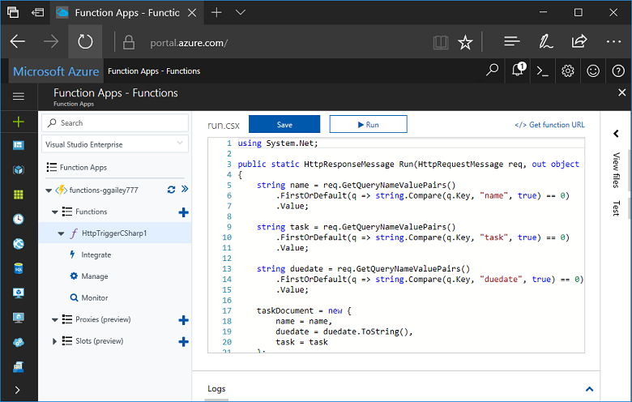
cloud wars
Azure functions
Aws lambda
https://docs.microsoft.com/en-us/azure/azure-functions/functions-create-first-azure-function

Slide 49
cloud wars
ortamlar
entegrasyon
Azure functions
vs
Aws lambda
dil destegi
language support

Slide 50
cloud wars
ortamlar
entegrasyon
Azure functions
vs
Aws lambda
V1
C#
JavaScript
F#
Python*
PHP*
Powershell*
V2 (Preview)
C#
JavaScript
Java
JavaScript
Python
Java
C# (.NET Core)
Go
Runtime API**
* Deneysel
** Restfull API sağlanıyor.

Slide 51
cloud wars
ortamlar
entegrasyon
Azure functions
açik kaynak
open source

Slide 52
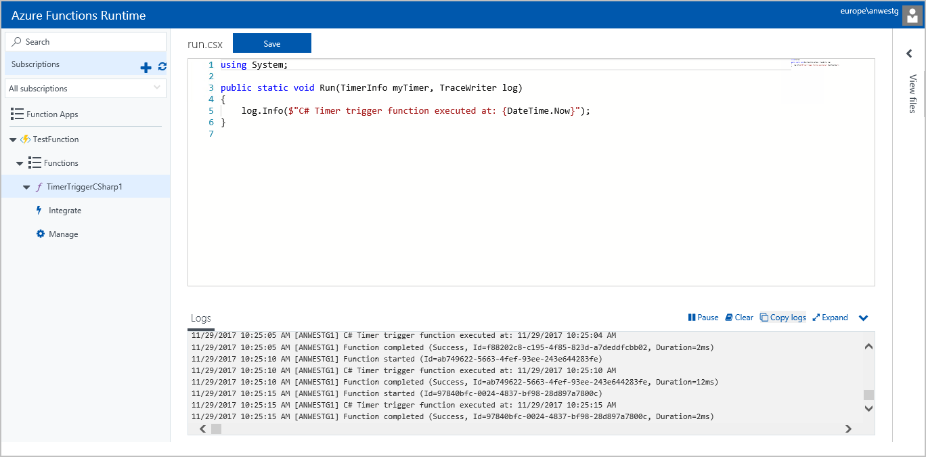
cloud wars
Azure functions
https://docs.microsoft.com/en-us/azure/azure-functions/functions-runtime-overview

Slide 53
cloud wars
servisler
services

Slide 54
cloud wars
servisler
Depolama
storage

Slide 55
cloud wars
servisler
depolama
nesne
object

Slide 56


cloud wars
servisler
depolama
nesne
vs
Azure storage
Block blob
Amazon simple storage service
(s3)

Slide 57
cloud wars
servisler
depolama
nesne
Azure storage block
blob
vs
Amazon simple storage service (s3)
replikasyon
replication

Slide 58
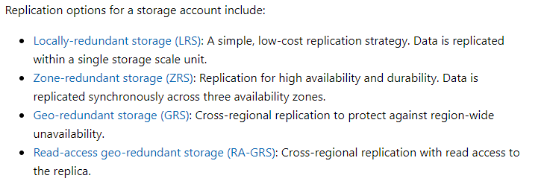
cloud wars
Azure storage – block blob
Amazon s3
https://docs.microsoft.com/en-us/azure/storage/common/storage-introduction

Slide 59
cloud wars
Azure storage – block blob
Amazon s3
zone replication

Slide 60
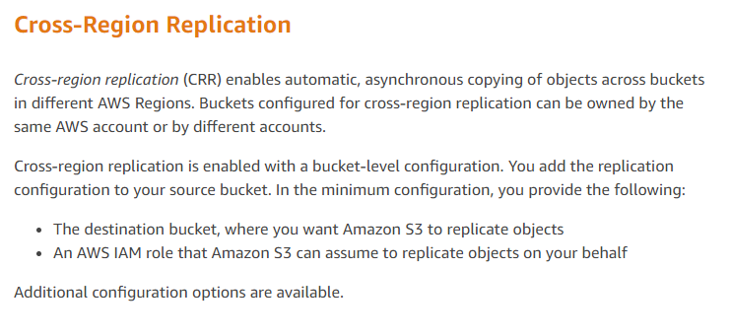
cloud wars
Azure storage – block blob
Amazon s3
https://docs.aws.amazon.com/AmazonS3/latest/dev/crr.html

Slide 61
cloud wars
servisler
depolama
nesne
Azure storage block
blob
vs
Amazon simple storage service (s3)
static website hosting

Slide 62
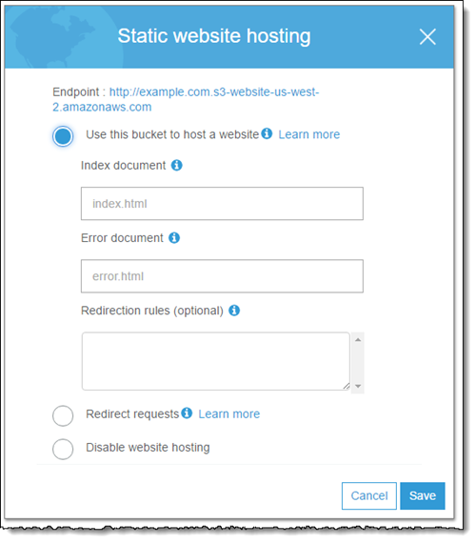
cloud wars
Azure storage – block blob
Amazon s3
https://docs.aws.amazon.com/en_us/AmazonS3/latest/dev/website-hosting-custom-domain-walkthrough.html

Slide 63
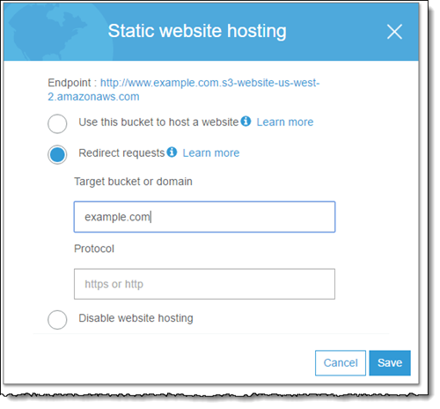
cloud wars
Azure storage – block blob
Amazon s3
https://docs.aws.amazon.com/en_us/AmazonS3/latest/dev/website-hosting-custom-domain-walkthrough.html

Slide 64
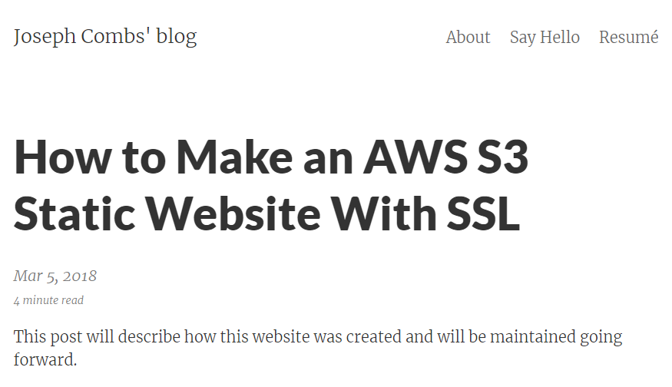
cloud wars
Azure storage – block blob
Amazon s3
https://www.josephecombs.com/2018/03/05/how-to-make-an-AWS-S3-static-website-with-ssl

Slide 65
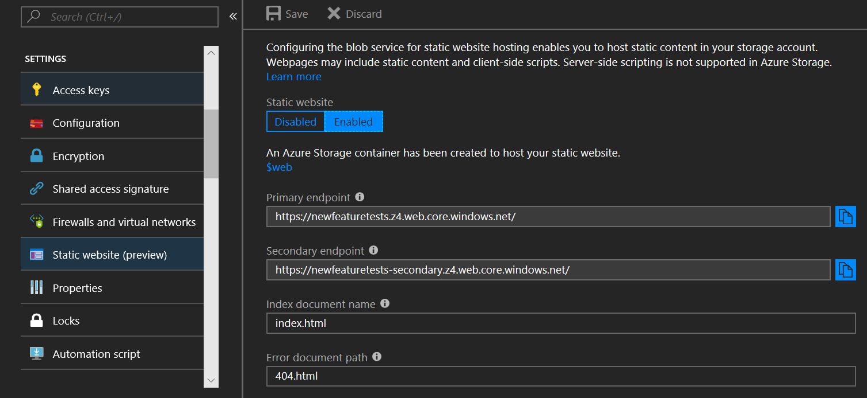
cloud wars
Azure storage – block blob
Amazon s3
https://azure.microsoft.com/en-us/blog/azure-storage-static-web-hosting-public-preview/

Slide 66
cloud wars
servisler
depolama
Dosya sistemi
File system

Slide 67


cloud wars
servisler
depolama
Dosya sistemi
vs
Azure storage
files
Amazon elastic file system
(efs)

Slide 68
cloud wars
servisler
depolama
Dosya sistemi
Azure storage
files
vs
Amazon elastic file system
(efs)
protokol

Slide 69
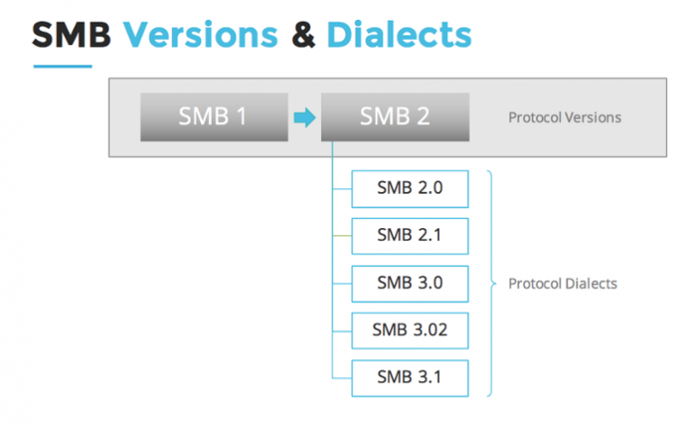
cloud wars
Azure storage - files
Amazon efs
azure
https://accedian.com/enterprises/blog/troubleshooting-smb-performance/

Slide 70
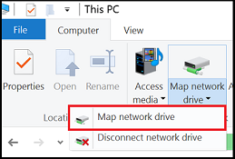
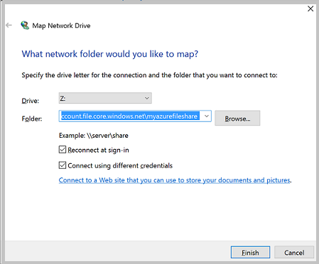
cloud wars
Azure storage - files
Amazon efs
azure

Slide 71
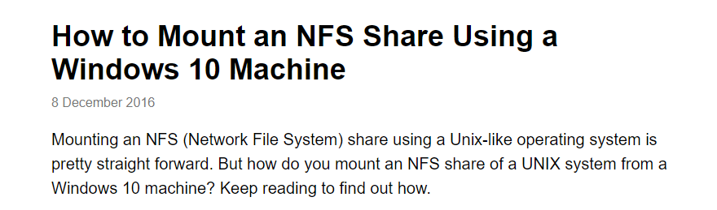
cloud wars
Azure storage - files
Amazon efs
Amazon
https://graspingtech.com/mount-nfs-share-windows-10/

Slide 72
cloud wars
servisler
depolama
disk

Slide 73


cloud wars
servisler
depolama
disk
vs
Azure storage page blob
Amazon elastic block storage
(ebs)

Slide 74
cloud wars
servisler
depolama
arsiv
archive

Slide 75
cloud wars
servisler
depolama
arsiv
Yakin gelecek

Slide 76
cloud wars
servisler
depolama
arsiv
Yakin gelecek
vs
Azure storage block blob
(cool)
Amazon s3
(infrequent access)

Slide 77
cloud wars
servisler
depolama
arsiv
uzak gelecek

Slide 78

cloud wars
servisler
depolama
arsiv
uzak gelecek
vs
Azure storage block blob
(archive)
Amazon glacier

Slide 79
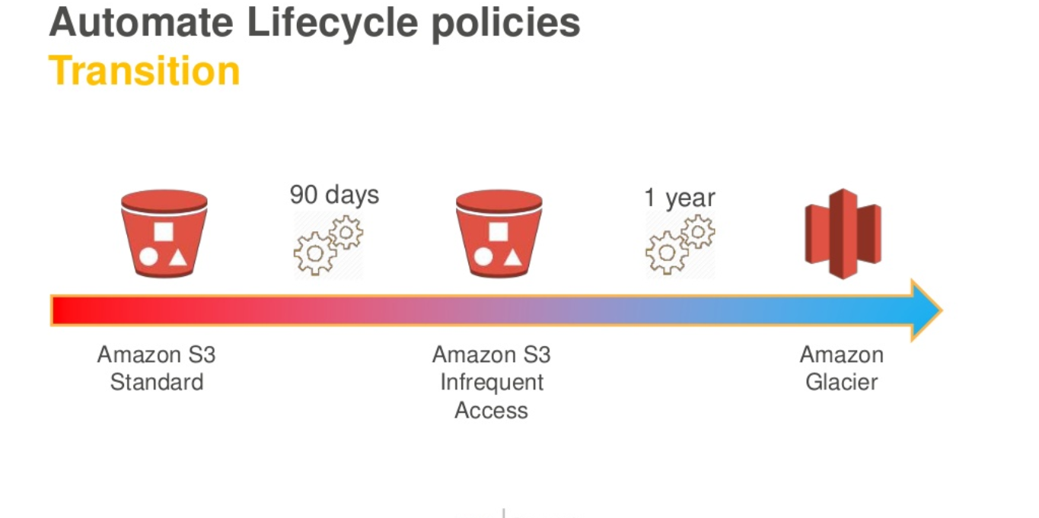
cloud wars
Amazon storage
https://www.slideshare.net/AmazonWebServices/deep-dive-on-object-storage-amazon-s3-and-amazon-glacier-79931704

Slide 80
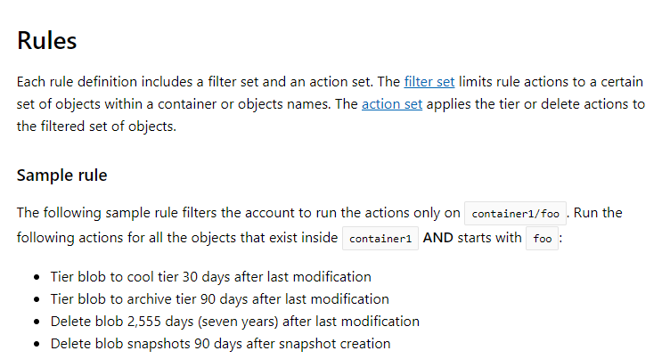
cloud wars
Azure storage
https://docs.microsoft.com/en-us/azure/storage/blobs/storage-lifecycle-management-concepts

Slide 81
cloud wars
servisler
veri tabani
database

Slide 82
cloud wars
servisler
veri tabani
sql

Slide 83





cloud wars
servisler
veri tabani
sql
vs
Azure sql databases
Amazon rds

Slide 84
cloud wars
servisler
veri tabani
sql
Azure sql database
vs
Amazon rds
platform

Slide 85
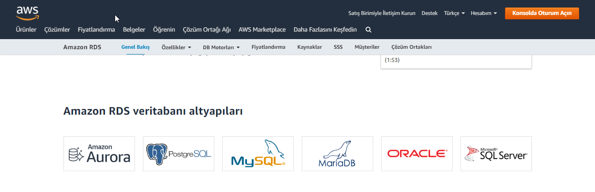
cloud wars
azure sql database
Amazon rds
https://aws.amazon.com/tr/rds/

Slide 86
cloud wars
servisler
veri tabani
nosql

Slide 87


cloud wars
servisler
veri tabani
nosql
vs
Azure cosmos db
Amazon dynamodb

Slide 88
cloud wars
servisler
veri tabani
nosql
Azure cosmos db
vs
Amazon dynamodb
in-memory

Slide 89
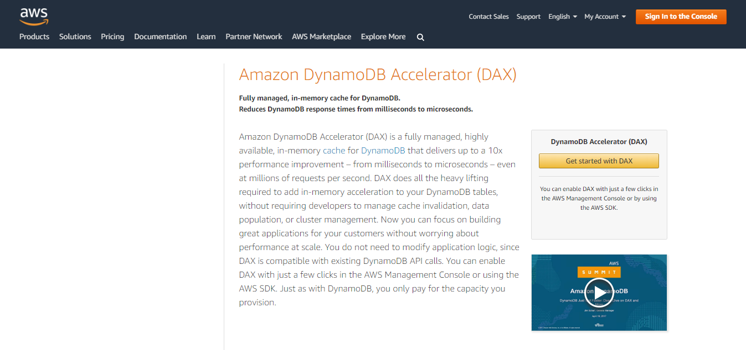
cloud wars
Azure cosmos db
Amazon dynamodb
https://aws.amazon.com/dynamodb/dax/

Slide 90
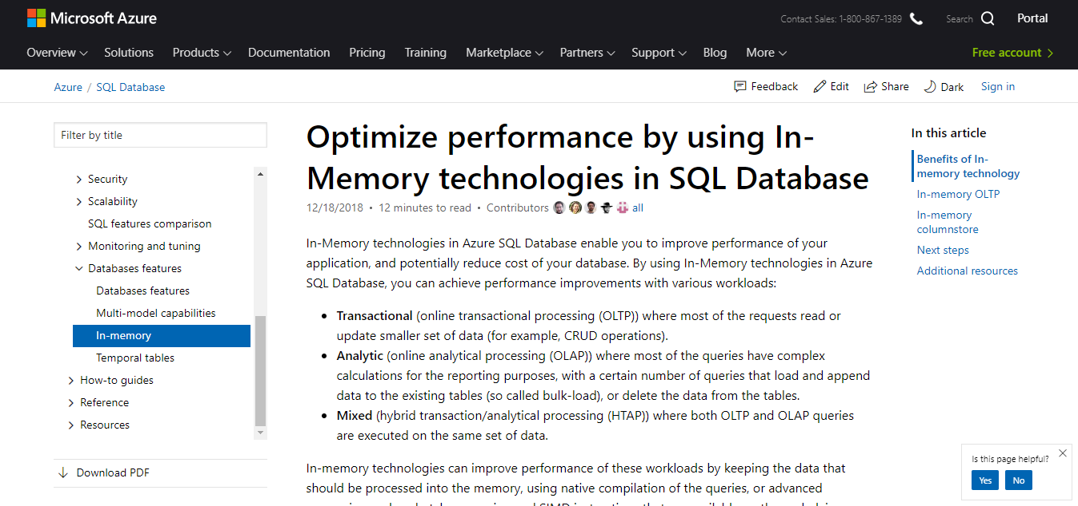
cloud wars
Azure cosmos db
Amazon dynamodb
https://docs.microsoft.com/en-us/azure/sql-database/sql-database-in-memory

Slide 91
cloud wars
servisler
veri tabani
cache

Slide 92


cloud wars
servisler
veri tabani
cache
vs
Azure redis cache
Amazon elasticache

Slide 93
cloud wars
servisler
büyük veri
big data

Slide 94
cloud wars
servisler
büyük veri
Gerçek zamanli analiz
Real time analysis

Slide 95


cloud wars
servisler
büyük veri
Gerçek zamanli analiz
vs
Azure stream analytics
Amazon kinesis

Slide 96
cloud wars
servisler
büyük veri
Gerçek zamanli analiz
Azure stream analytics
vs
Amazon kinesis
input - output

Slide 97
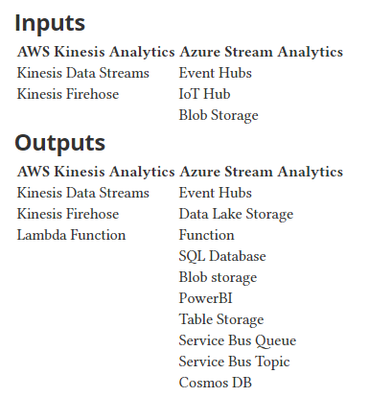
cloud wars
Azure stream analytics
Amazon kinesis
http://christofer.lof.io/2018/03/17/aws-kinesis-and-azure-eventhubs.html

Slide 98
cloud wars
servisler
büyük veri
Gerçek zamanli analiz
Azure stream analytics
vs
Amazon kinesis
window functions

Slide 99
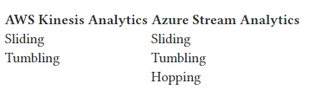
cloud wars
Azure stream analytics
Amazon kinesis
http://christofer.lof.io/2018/03/17/aws-kinesis-and-azure-eventhubs.html

Slide 100
cloud wars
servisler
büyük veri
isleme
Processing

Slide 101


cloud wars
servisler
büyük veri
isleme
vs
Azure hdinsight
Amazon emr

Slide 102
cloud wars
servisler
büyük veri
isleme
vs
Azure hdinsight
Amazon emr
desteklenen kütüphaneler

Slide 103

cloud wars
Azure hdinsight
Amazon emr
https://aws.amazon.com/emr/

Slide 104

cloud wars
Azure hdinsight
Amazon emr
https://azure.microsoft.com/tr-tr/services/hdinsight/

Slide 105
cloud wars
servisler
büyük veri
Makine ogrenmesi
Machine learning

Slide 106


cloud wars
servisler
büyük veri
Makine ogrenmesi
vs
Azure Machine Learning Studio
Amazon Machine learning

Slide 107

cloud wars
Azure ml studio
Amazon ml
https://console.aws.amazon.com/machinelearning/home?region=us-east-1

Slide 108

cloud wars
Azure ml studio
Amazon ml
https://aws.amazon.com/blogs/mobile/predictive-maintenance-with-aws-iot-and-amazon-machine-learning/

Slide 109

cloud wars
Azure ml studio
Amazon ml
https://www.greymatter.com/corporate/hardcopy-article/straight-talking-66/

Slide 110

cloud wars
Azure ml studio
Amazon ml
https://aws.amazon.com/blogs/mobile/predictive-maintenance-with-aws-iot-and-amazon-machine-learning/

Slide 111

cloud wars
Azure ml studio
Amazon ml
https://docs.microsoft.com/en-us/azure/machine-learning/studio/algorithm-cheat-sheet

Slide 112


cloud wars
servisler
büyük veri
Makine ogrenmesi
vs
Azure Machine Learning service
Amazon sagemaker

Slide 113

cloud wars
Azure ml service
Amazon sagemaker
https://aws.amazon.com/blogs/machine-learning/simulate-quantum-systems-on-amazon-sagemaker/

Slide 114


cloud wars
Azure ml service
Amazon sagemaker
https://aws.amazon.com/blogs/machine-learning/simulate-quantum-systems-on-amazon-sagemaker/

Slide 115
cloud wars
Azure ml service
Amazon sagemaker
https://aws.amazon.com/blogs/machine-learning/simulate-quantum-systems-on-amazon-sagemaker/

Slide 116

cloud wars
Azure ml service
Amazon sagemaker
https://aws.amazon.com/blogs/machine-learning/simulate-quantum-systems-on-amazon-sagemaker/

Slide 117

cloud wars
Azure ml service
Amazon sagemaker
https://docs.microsoft.com/en-us/azure/machine-learning/service/overview-what-is-azure-ml

Slide 118

cloud wars
Azure ml service
Amazon sagemaker
https://docs.microsoft.com/en-us/azure/machine-learning/service/overview-what-is-azure-ml

Slide 119
cloud wars
servisler
bilissel cozumler
Cognitive services

Slide 120













cloud wars
servisler
bilissel cozumler
vs
Microsoft Cognitive Services
Amazon cognitive
apis

Slide 121

cloud wars
Mcs - computer vision
Amazon rekognition
nesne algilama
https://azure.microsoft.com/en-us/services/cognitive-services/computer-vision/

Slide 122

cloud wars
Mcs - computer vision
Amazon rekognition
nesne algilama
https://cloudacademy.com/blog/amazon-rekognition-image-analysis-tool/

Slide 123

cloud wars
Mcs - computer vision
Amazon rekognition
Yazi algilama
https://azure.microsoft.com/en-us/services/cognitive-services/computer-vision/

Slide 124

cloud wars
Mcs - computer vision
Amazon rekognition
Yazi algilama
https://docs.aws.amazon.com/rekognition/latest/dg/text-detecting-text-procedure.html

Slide 125


cloud wars
Mcs - computer vision
Amazon rekognition
ünlü algilama
https://aws.amazon.com/blogs/aws/amazon-rekognition-update-celebrity-recognition/

Slide 126

cloud wars
Mcs - computer vision
Amazon rekognition
ünlü algilama
https://azure.microsoft.com/en-us/services/cognitive-services/computer-vision/

Slide 127

cloud wars
Mcs - face
Amazon rekognition
Yüz algilama-analiz
https://azure.microsoft.com/en-us/services/cognitive-services/face/

Slide 128

cloud wars
Mcs - face
Amazon rekognition
Yüz algilama-analiz
https://cloudacademy.com/blog/amazon-rekognition-image-analysis-tool/

Slide 129

cloud wars
Mcs - face
Amazon rekognition
Yüz karsilastirma
https://cloudacademy.com/blog/amazon-rekognition-image-analysis-tool/

Slide 130

cloud wars
Mcs - face
Amazon rekognition
Yüz karsilastirma
https://azure.microsoft.com/en-us/services/cognitive-services/face/

Slide 131

cloud wars
içerik ölçümleme
https://azure.microsoft.com/en-us/services/cognitive-services/content-moderator/

Slide 132

cloud wars
Amazon rekognition
içerik ölçümleme
https://aws.amazon.com/blogs/aws/amazon-rekognition-update-image-moderation/

Slide 133

cloud wars
video indexer
Amazon rekognition
video içerik algilama
https://azure.microsoft.com/en-us/services/media-services/video-indexer/

Slide 134

cloud wars
Amazon rekognition
video içerik algilama
https://www.slideshare.net/AmazonWebServices/build-computer-vision-applications-with-amazon-rekognition-113883999

Slide 135

cloud wars
Mcs - text analytics
Amazon comprehend
Yazi analizi
https://azure.microsoft.com/en-us/services/cognitive-services/text-analytics/

Slide 136

cloud wars
Mcs - text analytics
Amazon comprehend
Yazi analizi
https://aws.amazon.com/tr/blogs/aws/amazon-comprehend-continuously-trained-natural-language-processing/

Slide 137

cloud wars
Bing speech
Amazon polly
Yazidan sese
https://azure.microsoft.com/en-us/services/cognitive-services/text-to-speech/

Slide 138

cloud wars
Bing speech
Amazon polly
Yazidan sese
https://aws.amazon.com/polly/?nc1=h_ls

Slide 139
cloud wars
Bing speech
Amazon polly
Yazidan sese
ingilizce test
Erkek
kadin
Amazon polly
Bing speech

Slide 140


cloud wars
Bing speech
Amazon transcribe
Sesten yaziya
https://azure.microsoft.com/en-us/services/cognitive-services/speech-to-text/

Slide 141

cloud wars
Bing speech
Amazon transcribe
Sesten yaziya
https://aws.amazon.com/tr/transcribe/

Slide 142

cloud wars
Microsoft cognitive services
Ses ve yazi analizi
https://azure.microsoft.com/en-us/services/cognitive-services/directory/speech/

Slide 143


cloud wars
Azure bot services
Amazon lex
Chat bot
https://aws.amazon.com/tr/lex/

Slide 144

cloud wars
Azure bot services
Amazon lex
Chat bot
https://azure.microsoft.com/en-us/services/bot-service/

Slide 145
cloud wars
q n a

Slide 146
cloud wars
tesekkurler

Slide 147
cloud wars
kaynaklar
intro videosu
starwarsintrocreator.kassellabs.io
Azure icon set
bit.ly/1PwKRCG
aws icon set
amzn.to/2Qxxy77
Font-star jedi
https://www.dafont.com/star-jedi.font

